Slide 1
Agent-Based Negotiation
Dr Enrico Gerding
eg@ecs.soton.ac.uk
COMP6203 Intelligent Agents

Slide 2
Part 1

Slide 3
Learning Outcomes/Aims
This lecture will cover:
Approaches for conflict resolution between agents
Negotiation protocols
Negotiation behaviour
Types of negotiation environments: e.g. single-issue (zero-sum), multi-issue, etc
This lecture will introduce the concepts informally whereas Part 2 will introduce formal notation to discuss these aspects.

Slide 4
Conflict of interest between agents
Conflict arises when agents have different preferences or aims
Conflicts of interest are a daily occurrence for people
Households: Who does the washing up? Where do we go out for dinner? What temperature should the house be? Who gets to use the car? Where and when do we meet up? Etc
Commerce, Business (contract negotiation) and Politics (e.g. trade agreements)
Similarly, in a multi-agent system conflicts arise when agents are self-interested (e.g. maximising their own benefit) and the agents represent different stakeholders (i.e. different sets of interests/aims)
For example, a buyer wants to pay as little as possible, whereas a seller wants to maximise profits, resulting in a conflict

Slide 5
Conflict resolution
Conflict resolution is possible when there is a mutual benefit to reach an agreement, i.e. there is a conflict of interest, but agents are better off by reaching an agreement than not reaching one
Approaches for conflict resolution:
Auctions
Voting
Negotiation
Different approaches suitable for different types of settings

Slide 6
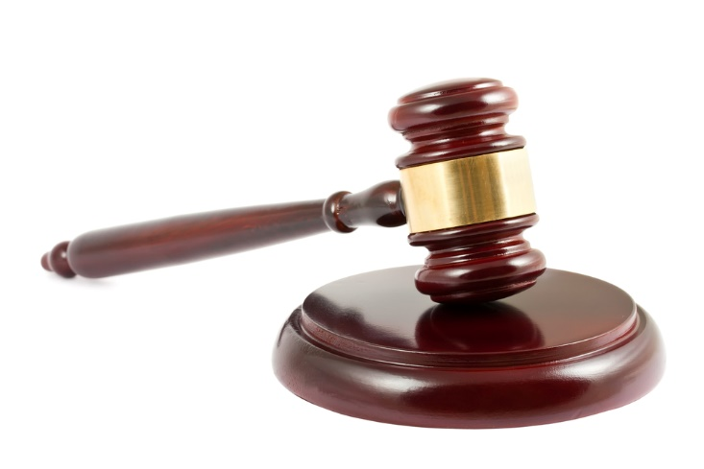
Auctions
Primarily used to allocate scarce resources or tasks, e.g.:
Items to buyers
Advertising space to advertisers (sponsored search and display advertising)
Cloud computing
Tasks to robots
Stocks and shares (financial exchanges)
…
Characterised by:
Clearly defined protocol (aka rules or mechanism), e.g. English auction, Dutch auction, Vickrey auction
Typically requires a trusted third party, i.e. auctioneer
Often involves a continuous resource such as money
Exploits competition between agents (works better with more agents)

Slide 7

Voting
Used for group based decisions, so called social choice, e.g.
Where to go out to dinner
Where to build new bridge/services/housing
What temperature the house should be
(In politics) Choosing party/representative
Characterised by
A single decision from a (typically finite) number of options
Each agent can have different preferences each option, which is given by a preference order (a.k.a. ordinal utility function)
Clearly defined protocol

Slide 8
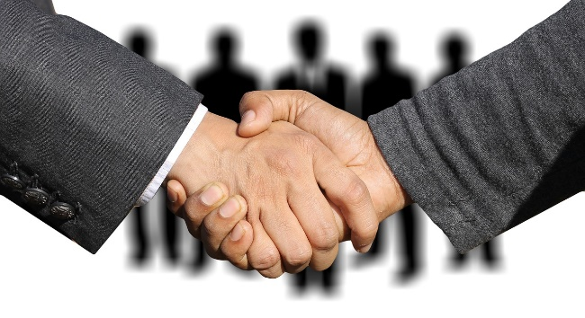
Negotiation (a.k.a. Bargaining)
Negotiation is governed by a protocol which defines the “rules of encounter” between the agents, including:
Type of communication allowed
Type of proposals that are allowed
Who can make what proposal at what time
More flexible compared to other approaches:
Protocol typically involves exchanging offers, but can also include other information such as arguments (i.e. reasons why)
Allows for less structured protocols
Often bilateral (between two agents), but some protocols support multi-party negotiation (between more than two agents)
Enables more complex types of agreements (e.g. multi-issue negotiation)
Often decentralised (can involve mediator – agent-mediated negotiation)

Slide 9
Characterising Agent Negotiations (cont.)
Negotiation environment: set of possible outcomes/agreements
Single-issue negotiation (aka distributive bargaining): e.g. price. Win-lose, competitive setting
Multi-issue negotiation (integrative bargaining): include more issues, allows for mutual benefit and cooperation
Agent preferences
The preferences over all possible agreements (and disagreement), typically specified using utility functions
Agent negotiation strategies
Specifies the behaviour of the agents
Actions employed (e.g. the proposals made) at each possible decision point, given the information available to the agent

Slide 10
Negotiation Protocols
Ultimatum Game
Alternating Offers
Monotonic Concession Protocol
Divide and Choose

Slide 11
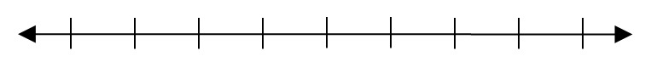
Single-Issue Negotiation
Agent 1
Agent 2
Agreement Space

Slide 12
Single-Issue Negotiation: Price
seller’s reserve price
buyer’s maximum willingness to pay
Buyer Agent
Seller Agent
Price
Agreement Space

Slide 13
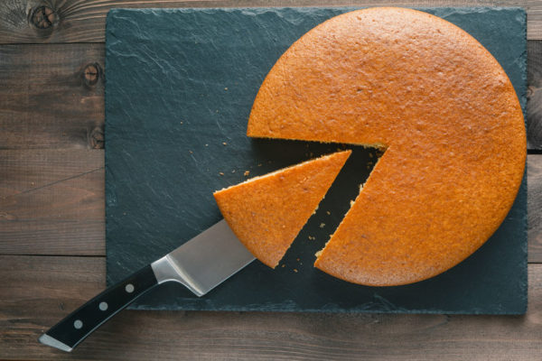
Agreement Space as a Pie/Cake
Negotiation Problem becomes: How to divide a (uniform) cake between two agents?

Slide 14
Bilateral Negotiation: The Ultimatum Game
Agent 1 suggests a division of the cake
Agent 2 can only choose to accept or reject the cake
If agent 2 rejects, no-one gets any cake (the cake gets thrown away)
Also known as “take it or leave it” game

Slide 15
Reflection Exercise 1
Before moving to next slide, pause the video and have a think about the following points:
What would good strategies be of the agents if they are completely selfish (and rational)
Is this a good negotiation protocol? What are the advantages and disadvantages?
What could be alternative protocols?

Slide 16
Reflection Exercise 1 Explained: (Rational) Behaviour in the Ultimatum Game
Suppose agent 1 offers agent 2 half the cake. Will agent 2 accept if she/he is rational?
What about less than half the cake?
What about a tiny sliver of cake?
So what’s agent’s 1 best strategy, given agent 2’s behaviour?
This type of thinking is formalised in game theory, which analyses such rational, strategic behaviour between self-interested agents. We will cover the topic of game theory extensively in these lectures.

Slide 17
Reflection Exercise 1 Explained: Advantages/Disadvantages
Agent 1 has a clear advantage, the so-called first-mover advantage
Results in outcomes that can be seen as unfair
Assumes that agreement space (a.k.a. the size of the pie) is “known”, i.e. the seller’s reserve and buyer’s willingness to pay are shared knowledge
No ability to explore the negotiation space, which is especially important when there are multiple issues (as we will discuss later)

Slide 18
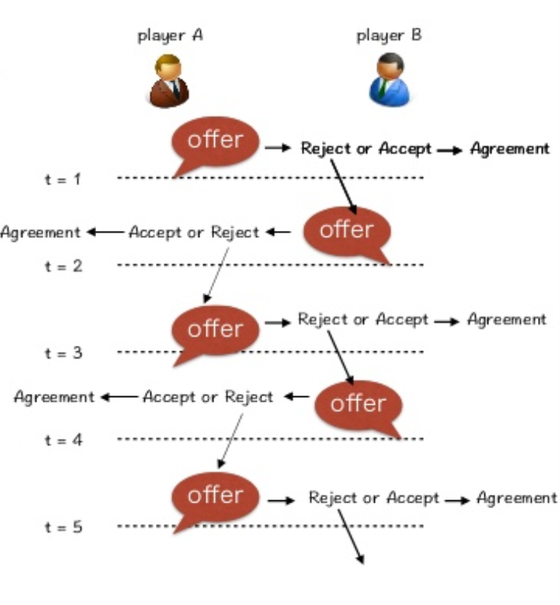
Alternating Offers Protocol
Negotiation consists of a number of rounds
Agents exchange offers in an alternating fashion
First player starts with proposing an offer. Second player can either accept or reject and counter offer, or reject and break off negotiation.
Negotiation ends after set number of rounds (i.e. deadline) or if either players breaks off negotiations

Slide 19
Reflection Exercise 2
What are good strategies for the alternating offer game?
How does the protocol compare to the ultimatum game?

Slide 20
Reflection Exercise 2 Explained
Although the protocol offers exchange of more rounds, is there any incentive for any of the agents to concede?
Note that there is a final round which is crucial here
The last round is identical to the ultimatum game
So depending on who gets to make the last offer, they can again propose a take-it-or-leave-it offer, which a rational agent would accept
So we need some way to incentivise a concession.
This can be due to some form of time pressure (discussed in Part 2), or by changing the protocol (discussed next)

Slide 21
Monotonic Concession Protocol
Negotiations proceed in rounds
In each round, the agents simultaneously propose offers (without seeing the other offer)
If both offers “match” then one of them is chosen
If offers don’t match, then negotiation proceeds to the next round
In the next round, at least one of the agents need to concede.
If neither of the agent concedes, the negotiation ends without a deal.

Slide 22
Divide and Choose
In case the “cake” denotes a continuous resource that needs to be divided between multiple agents (e.g. inheritance money or land) then the “divide and choose” protocol can be used. Note it does not make sense for other types of negotiations such as price negotiation.
The protocol consists of 2 steps:
First, Agent 1 divides the cake into 2 portions
First, Agent 2 chooses one of the portions

Slide 23
Reflection Exercise 3
What is the optimal strategy of the agents?
Is the outcome fair?

Slide 24
Reflection Exercise Explained+Additional Notes
Since agent 2 is going to choose the best portion for them, agent 1 has an incentive to divide the cake equally.
So each agent ends up with half
Remember that this protocol only works for so-called resource allocation problems, where there is some (continuous) resource that needs to be divided between multiple agents
This protocol also works for non-homogenous resources, e.g. when parts of the cake are more attractive (e.g. in the case of land division)
There are equivalent protocols for more than 2 agents, but this gets more complicated

Slide 25
Desirable properties of a negotiation
A deal should be better than no deal for all agents (individual rationality)
There should be “no money” (or cake) left on the table (Pareto efficiency)
The agreement should be “fair”
We will formalise these terms in Part 2

Slide 26
Part 2

Slide 27
Learning Outcomes/Aims
This lecture will cover:
Concept of utility function to capture agent preferences
Formalising different types of negotiation environments: time pressure, single-issue (zero-sum), multi-issue
Desirable properties of negotiation outcomes, including Pareto efficiency and fairness

Slide 28
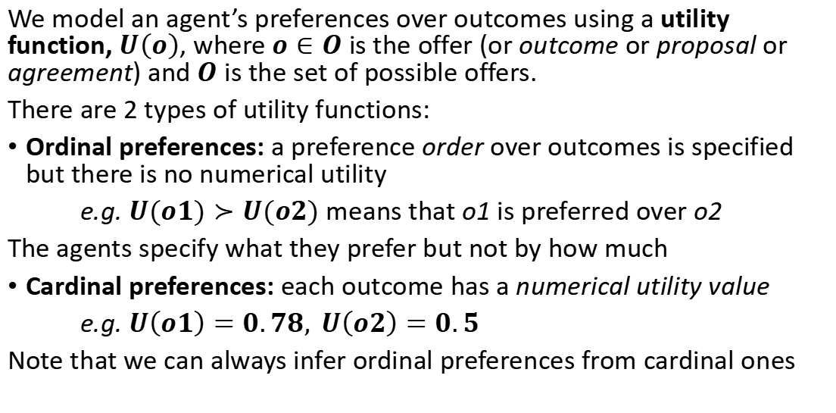
Agent Preferences: Formal
We model an agent’s preferences over outcomes using a utility function, $U\left(o\right)$, where $o∈O$ is the offer (or outcome or proposal or agreement) and $O$ is the set of possible offers.
There are 2 types of utility functions:
Ordinal preferences: a preference order over outcomes is specified but there is no numerical utility
e.g. $U(o1)≻U(o2)$ means that o1 is preferred over o2
The agents specify what they prefer but not by how much
Cardinal preferences: each outcome has a numerical utility value
e.g. $U\left(o1\right)=0.78, U\left(o2\right)=0.5$
Note that we can always infer ordinal preferences from cardinal ones

Slide 29
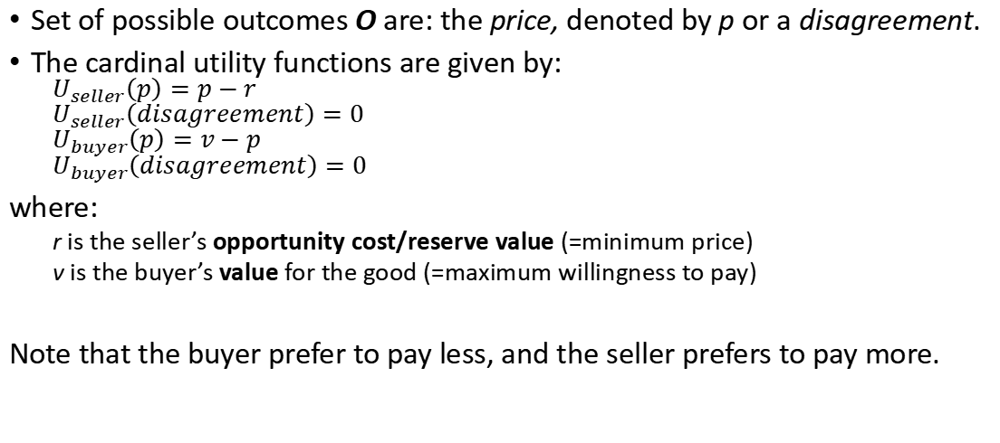
Example: Buyer/Seller Price Negotiation
Set of possible outcomes O are: the price, denoted by p or a disagreement.
The cardinal utility functions are given by:
$$U_{seller}\left(p\right)=p−r$$
$$U_{seller}\left(disagreement\right)=0$$
$$U_{buyer}\left(p\right)=v−p$$
$$U_{buyer}\left(disagreement\right)=0$$
where:
r is the seller’s opportunity cost/reserve value (=minimum price)
v is the buyer’s value for the good (=maximum willingness to pay)
Note that the buyer prefer to pay less, and the seller prefers to pay more.

Slide 30
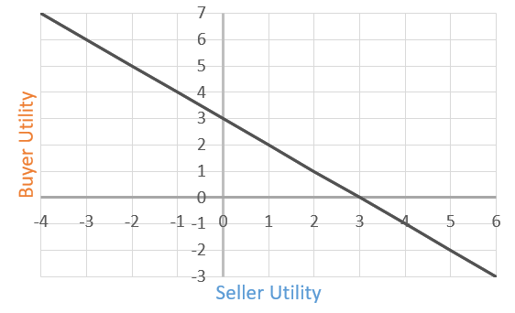
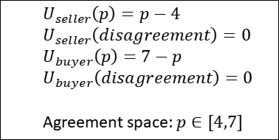
Price Negotiation: Utility Space
We can visualise the outcomes using the utility space, which shows the utility of the two agents on respective axis for all possible outcomes (i.e. prices)
In this example:
Seller’s reservation value is set to r=4
Buyer’s valuation/willingness to pay is set to v=7
$$U_{seller}\left(p\right)=p−4$$
$$U_{seller}\left(disagreement\right)=0$$
$$U_{buyer}\left(p\right)=7−p$$
$$U_{buyer}\left(disagreement\right)=0$$
Agreement space: $p∈[4,7]$
Price hits seller reserve price p=r=4
Agreement space
Price hits buyer’s willingness to pay p=v=7
disagreement

Slide 31
Time pressure
Negotiation cannot go on for infinity
Several reasons for time pressure and different ways to model them:
Deadlines
Imposed by protocol (e.g. Ultimatum game is 1 round)
Or determined by individual constraints – in which case deadlines of agents can differ
Break-off probability
Imposed by protocol (e.g. like the monotonic concession protocol)
Or agents can decide to break off negotiations themselves
Bargaining costs
Fixed bargaining costs per round
Discount factors

Slide 32
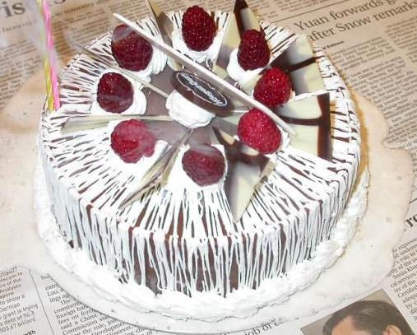
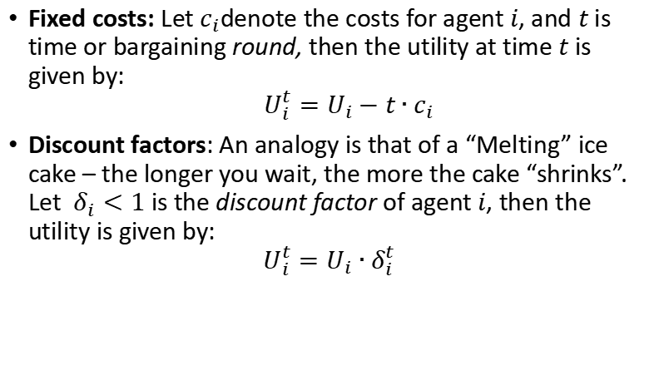
Modelling bargaining costs
Fixed costs: Let $c_{i}$denote the costs for agent $i$, and $t$ is time or bargaining round, then the utility at time $t$ is given by: $$U_{i}^{t}=U_{i}−t∙c_{i}$$
Discount factors: An analogy is that of a “Melting” ice cake – the longer you wait, the more the cake “shrinks”. Let $δ_{i}<1$ is the discount factor of agent $i$, then the utility is given by:
$$U_{i}^{t}=U_{i}∙δ_{i}^{t}$$

Slide 33
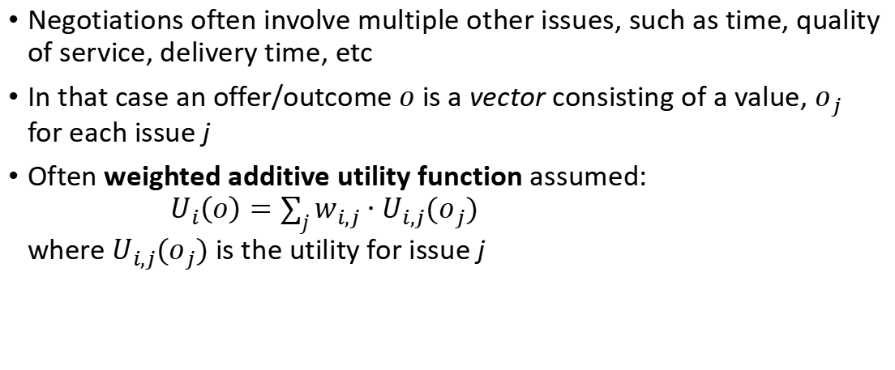
Multi-Issue Negotiation
Negotiations often involve multiple other issues, such as time, quality of service, delivery time, etc
In that case an offer/outcome $o$ is a vector consisting of a value, $o_{j}$ for each issue j
Often weighted additive utility function assumed: $U_{i}\left(o\right)=\sum_{j}{w_{i,j}∙U_{i,j}(o_{j})}$ where $U_{i,j}(o_{j})$ is the utility for issue j

Slide 34
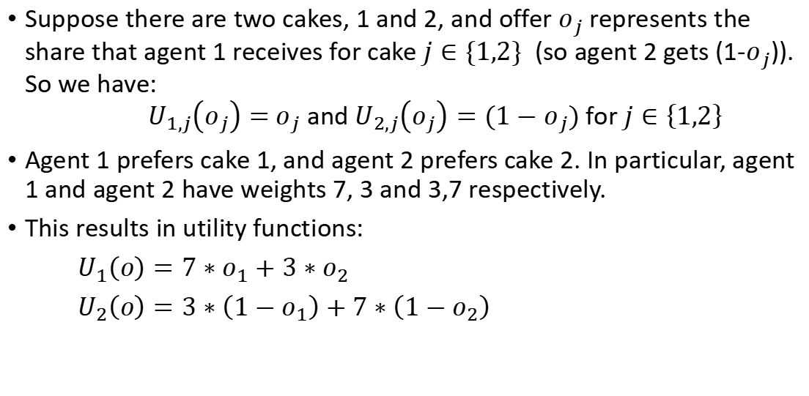
Additive Utility Function Example
Suppose there are two cakes, 1 and 2, and offer $o_{j}$ represents the share that agent 1 receives for cake $j∈\{1,2\}$ (so agent 2 gets (1-$o_{j}$)). So we have: $U_{1,j}\left(o_{j}\right)=$ $o_{j}$ and $U_{2,j}\left(o_{j}\right)=(1−o_{j})$ for $j∈\left\{1,2\right\}$
Agent 1 prefers cake 1, and agent 2 prefers cake 2. In particular, agent 1 and agent 2 have weights 7, 3 and 3,7 respectively.
This results in utility functions:
$U_{1}\left(o\right)=7∗o_{1}+3∗o_{2}$
$U_{2}\left(o\right)=3∗\left(1−o_{1}\right)+7∗\left(1−o_{2}\right)$

Slide 35
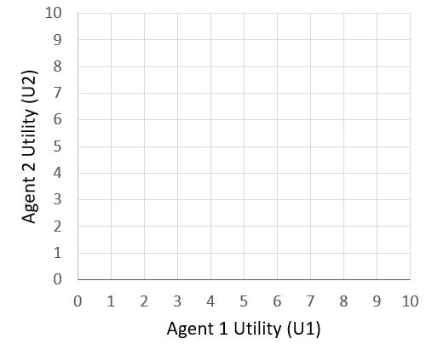
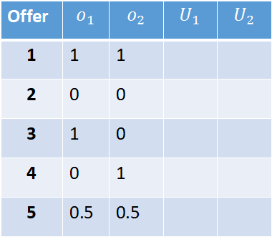
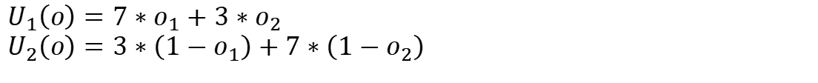
Utility Space: Exercise
$$U_{1}\left(o\right)=7∗o_{1}+3∗o_{2}$$
$$U_{2}\left(o\right)=3∗\left(1−o_{1}\right)+7∗\left(1−o_{2}\right)$$
Offer | $$o_{1}$$ | $$o_{2}$$ | $$U_{1}$$ | $$U_{2}$$
1 | 1 | 1
2 | 0 | 0
3 | 1 | 0
4 | 0 | 1
5 | 0.5 | 0.5

Slide 36
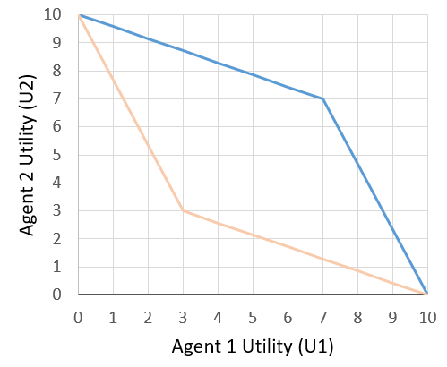
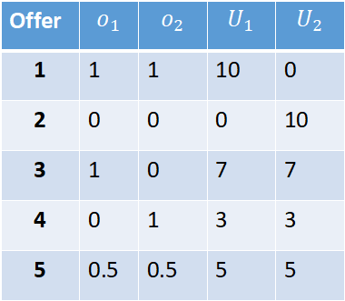
Example Utility Space (Answer)
$$U_{1}\left(o\right)=7∗o_{1}+3∗o_{2}$$
$$U_{2}\left(o\right)=3∗\left(1−o_{1}\right)+7∗\left(1−o_{2}\right)$$
2
Offer | $$o_{1}$$ | $$o_{2}$$ | $$U_{1}$$ | $$U_{2}$$
1 | 1 | 1 | 10 | 0
2 | 0 | 0 | 0 | 10
3 | 1 | 0 | 7 | 7
4 | 0 | 1 | 3 | 3
5 | 0.5 | 0.5 | 5 | 5
3
5
Agreement space
4
1

Slide 37
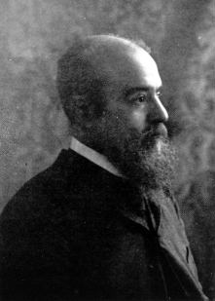
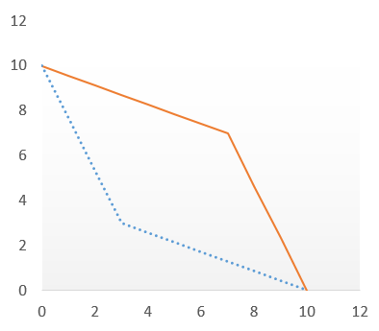


Pareto-Efficient Agreements
An agreement is said to be Pareto efficient (or Pareto optimal) if no further improvement is possible in the utility of one agent, without reducing the utility of the other agents
Pareto efficient frontier: Set of all Pareto efficient agreements
Taking previous example:
Pareto efficient frontier
Wilfredo Pareto
Agent 2's utility ($U_{2}$)
set of possible agreements
Agent 1's utility ($U_{1}$)

Slide 38
Desirable properties
Agreements should be individually rational: U(o)>U(disagreement)
Agreements should be Pareto efficient
Agreements should be fair

Slide 39
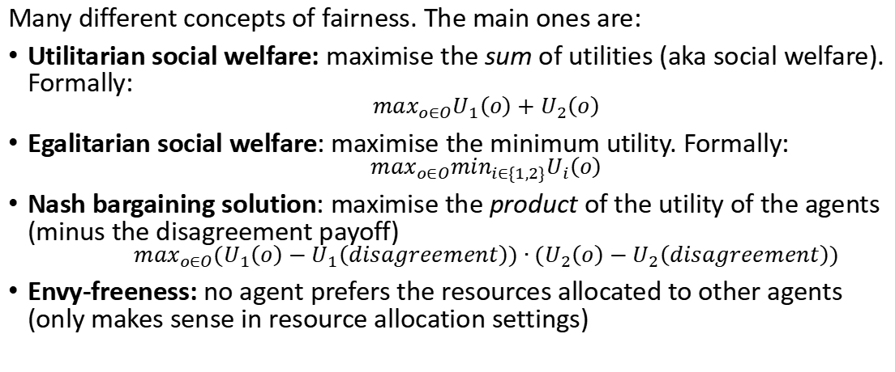
Fairness
Many different concepts of fairness. The main ones are:
Utilitarian social welfare: maximise the sum of utilities (aka social welfare). Formally:
$$\max_{o∈O}U_{1}\left(o\right)+U_{2}\left(o\right)$$
Egalitarian social welfare: maximise the minimum utility. Formally:
$$\max_{o∈O}{\min_{i∈\{1,2\}}U}_{i}\left(o\right)$$
Nash bargaining solution: maximise the product of the utility of the agents (minus the disagreement payoff)
$$\max_{o∈O}{(U}_{1}\left(o\right)−U_{1}\left(disagreement\right))∙{(U}_{2}\left(o\right)−U_{2}\left(disagreement\right))$$
Envy-freeness: no agent prefers the resources allocated to other agents (only makes sense in resource allocation settings)

Slide 40
Nash Bargaining Solution
John Nash (also known for his Nash equilibrium and the movie Beautiful Mind) showed that the Nash bargaining solution is uniquely characterised by the following axioms or properties
Individual rationality: the solution always satisfies U1 ≥ U1(dis) and U2 ≥ U2(dis)
Pareto efficiency
Invariance to equivalent utility representations: the solution is insensitive to affine transformations
Independence of irrelevant alternatives (IIA): remove all the non-optimal agreements, and the optimal agreement remains the same
Symmetry (SYM): if the agents have the same preferences, then the solution gives them the same utilities

Slide 41
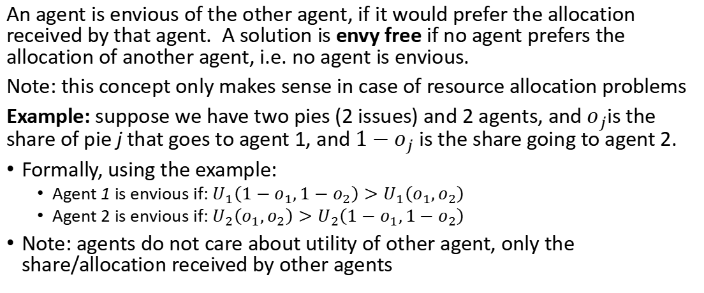
Envy-freeness
An agent is envious of the other agent, if it would prefer the allocation received by that agent. A solution is envy free if no agent prefers the allocation of another agent, i.e. no agent is envious.
Note: this concept only makes sense in case of resource allocation problems
Example: suppose we have two pies (2 issues) and 2 agents, and $o_{j}$is the share of pie j that goes to agent 1, and ${1−o}_{j}$ is the share going to agent 2.
Formally, using the example:
Agent 1 is envious if: $U_{1}\left({1−o}_{1},{1−o}_{2}\right)>U_{1}\left(o_{1},o_{2}\right)$
Agent 2 is envious if: $U_{2}\left(o_{1},o_{2}\right)>U_{2}\left(1−o_{1},1−o_{2}\right)$
Note: agents do not care about utility of other agent, only the share/allocation received by other agents

Slide 42
Exercise: Example 1 Revisited
Considering the example from before, which offer(s) satisfy:
Utilitarian social welfare solution
Egalitarian social welfare solution
Nash Bargaining solution
Envy-free

Slide 43
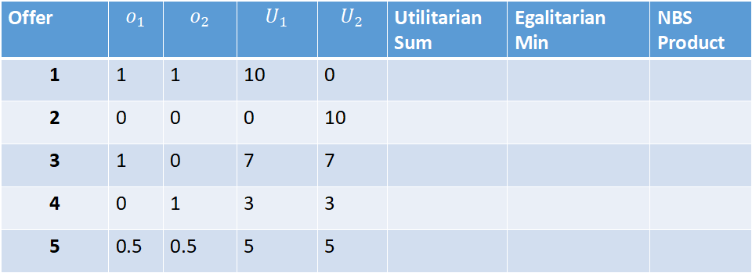
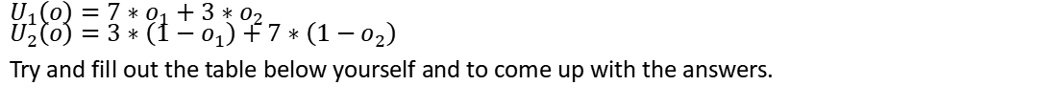
Example 1 Revisited
$$U_{1}\left(o\right)=7∗o_{1}+3∗o_{2}$$
$$U_{2}\left(o\right)=3∗\left(1−o_{1}\right)+7∗\left(1−o_{2}\right)$$
Try and fill out the table below yourself and to come up with the answers.
Offer | $$o_{1}$$ | $$o_{2}$$ | $$U_{1}$$ | $$U_{2}$$ | Utilitarian Sum | Egalitarian Min | NBS Product
1 | 1 | 1 | 10 | 0
2 | 0 | 0 | 0 | 10
3 | 1 | 0 | 7 | 7
4 | 0 | 1 | 3 | 3
5 | 0.5 | 0.5 | 5 | 5

Slide 44
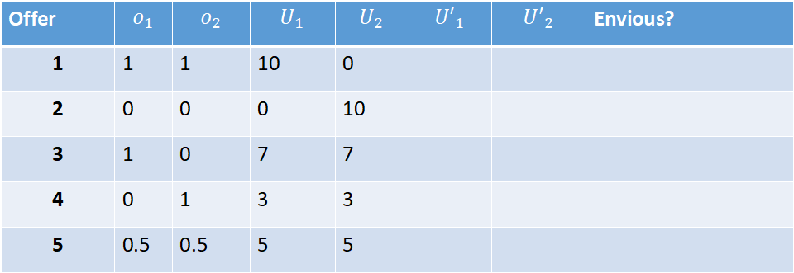
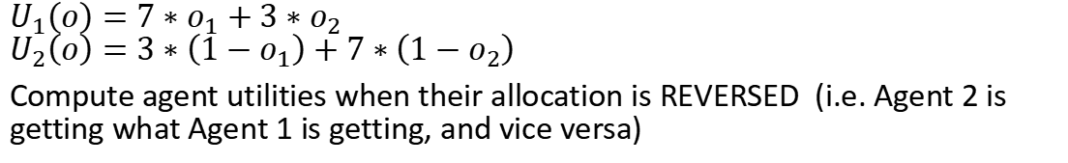
Example 1 Revisited: Envy Free
$$U_{1}\left(o\right)=7∗o_{1}+3∗o_{2}$$
$$U_{2}\left(o\right)=3∗\left(1−o_{1}\right)+7∗\left(1−o_{2}\right)$$
Compute agent utilities when their allocation is REVERSED (i.e. Agent 2 is getting what Agent 1 is getting, and vice versa)
Offer | $$o_{1}$$ | $$o_{2}$$ | $$U_{1}$$ | $$U_{2}$$ | $${U′}_{1}$$ | $${U′}_{2}$$ | Envious?
1 | 1 | 1 | 10 | 0
2 | 0 | 0 | 0 | 10
3 | 1 | 0 | 7 | 7
4 | 0 | 1 | 3 | 3
5 | 0.5 | 0.5 | 5 | 5

Slide 45
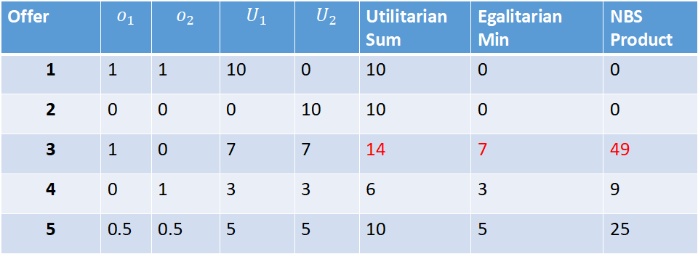
Example 1 Revisited (Answers)
$$U_{1}\left(o\right)=7∗o_{1}+3∗o_{2}$$
$$U_{2}\left(o\right)=3∗\left(1−o_{1}\right)+7∗\left(1−o_{2}\right)$$
Offer | $$o_{1}$$ | $$o_{2}$$ | $$U_{1}$$ | $$U_{2}$$ | Utilitarian Sum | Egalitarian Min | NBS Product
1 | 1 | 1 | 10 | 0 | 10 | 0 | 0
2 | 0 | 0 | 0 | 10 | 10 | 0 | 0
3 | 1 | 0 | 7 | 7 | 14 | 7 | 49
4 | 0 | 1 | 3 | 3 | 6 | 3 | 9
5 | 0.5 | 0.5 | 5 | 5 | 10 | 5 | 25

Slide 46
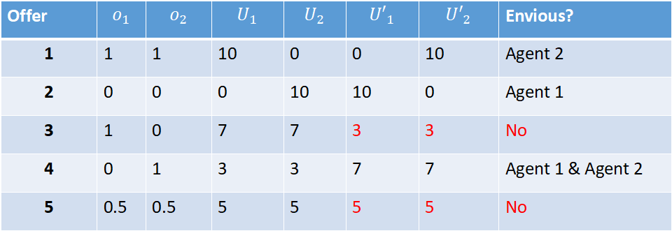
Example 1 Revisited: Envy Free
$$U_{1}\left(o\right)=7∗o_{1}+3∗o_{2}$$
$$U_{2}\left(o\right)=3∗\left(1−o_{1}\right)+7∗\left(1−o_{2}\right)$$
Compute agent utilities when their allocation is REVERSED (i.e. Agent 2 is getting what Agent 1 is getting, and vice versa)
Offer | $$o_{1}$$ | $$o_{2}$$ | $$U_{1}$$ | $$U_{2}$$ | $${U′}_{1}$$ | $${U′}_{2}$$ | Envious?
1 | 1 | 1 | 10 | 0 | 0 | 10 | Agent 2
2 | 0 | 0 | 0 | 10 | 10 | 0 | Agent 1
3 | 1 | 0 | 7 | 7 | 3 | 3 | No
4 | 0 | 1 | 3 | 3 | 7 | 7 | Agent 1 & Agent 2
5 | 0.5 | 0.5 | 5 | 5 | 5 | 5 | No
There are many others. E.g. (1.0,0.1) is envy free as well, and even (1.0,0.2). However, (1.0,0.3) is no longer envy free, since at that point agent 2 prefers agent 1’s allocation. CHECK YOURSELF!

Slide 47
Part 3

Slide 48
Learning Outcomes/Aims
This lecture will cover:
Basic negotiation strategies
Uncertainty about the opponent
Preference uncertainty
Concluding remarks

Slide 49
Negotiation Strategies. Approaches:
Game theoretic
Assumes rules of the game, preferences & beliefs of all players are common knowledge
Assumes full rationality on the part of all players (=unlimited computation)
Preferences encoded in a (limited) set of player types
Closed systems, predetermined interaction, small sized games
Nash equilibrium (discussed later in the module)
Heuristic perspective
No common knowledge or perfect rationality assumptions needed
Agent behaviour is modeled directly
Suitable for open, dynamic environments
Space of possibilities is very large

Slide 50
Heuristics
Heuristics are often used when there is some unknowns about the opponent, e.g. the strategy they are using
We can divide a strategy into:
Concession strategy: what should be the target utility I think I should achieve at a particular point in the negotiation?
Multi-Issue offer producing strategy: once a target utility is established, what offer to produce at or around that target utility (to ensure Pareto efficiency). Trivial in case of single issues.
Well-known concession strategies include:
Time-dependent tactics: only depend on time/current round of the negotiation and not on the opponent’s action
Tit-for-tat

Slide 51
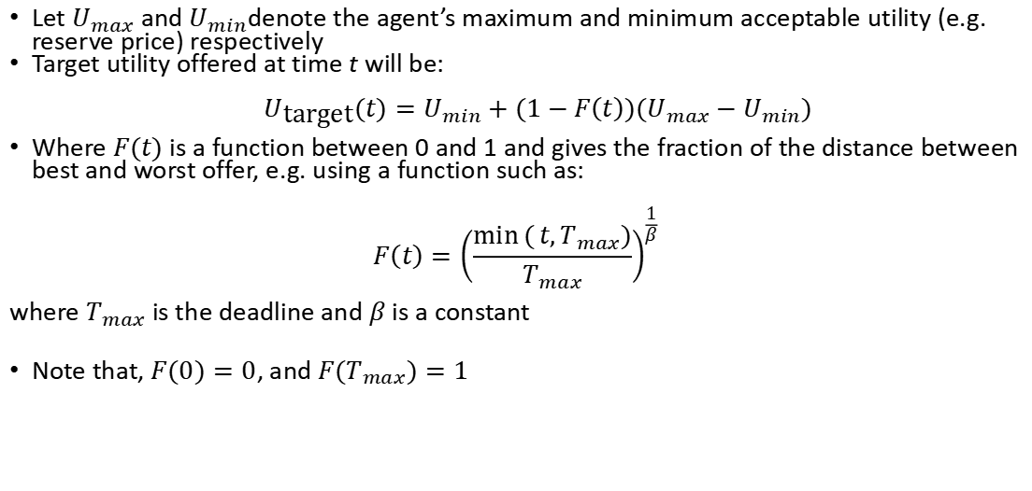
Concession: Time-dependent tactics
Let $U_{max}$ and $U_{min}$denote the agent’s maximum and minimum acceptable utility (e.g. reserve price) respectively
Target utility offered at time t will be: $$U_{\text{target}}(t)=U_{min}+(1−F\left(t\right))(U_{max}−U_{min})$$
Where $F(t)$is a function between 0 and 1 and gives the fraction of the distance between best and worst offer, e.g. using a function such as:
$$F\left(t\right)={\left(\frac{\min{(}t,T_{max})}{T_{max}}\right)}^{\frac{1}{β}}$$ where $T_{max}$ is the deadline and $β$ is a constant
Note that, $F(0)=0$, and $F(T_{max})=1$

Slide 52
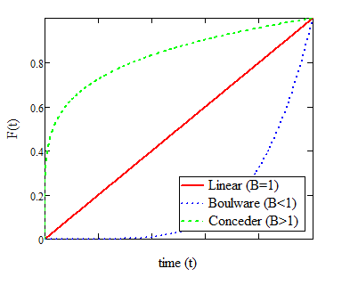
Time-dependent tactics (Cont.)
Hard-headed (β->0)
No concessions. Sticks to the initial offer throughout (hoping the opponent will concede)
Linear time-dependent concession (β=1)
Concession is linear in the time remaining until the deadline
Boulware (β<1)
Concedes very slowly; initial offer is maintained until just before the deadline
Conceder (β>1)
Concedes to the reservation value very quickly

Slide 53
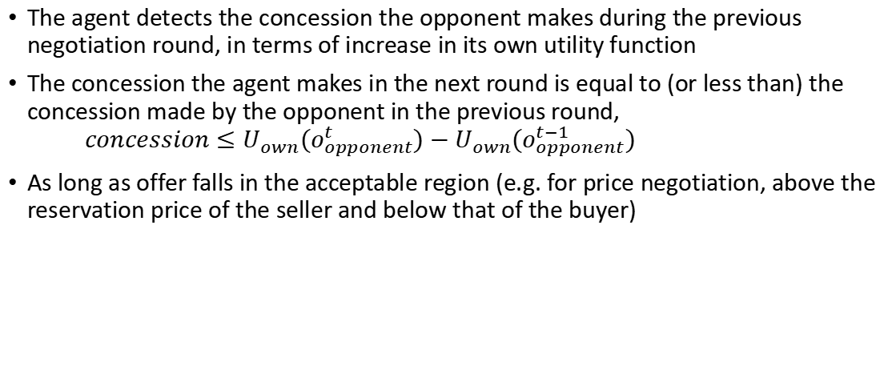
Tit-for-tat concession strategy
The agent detects the concession the opponent makes during the previous negotiation round, in terms of increase in its own utility function
The concession the agent makes in the next round is equal to (or less than) the concession made by the opponent in the previous round, $concession≤U_{own}(o_{opponent}^{t})−U_{own}(o_{opponent}^{t−1})$
As long as offer falls in the acceptable region (e.g. for price negotiation, above the reservation price of the seller and below that of the buyer)

Slide 54
Optimal Concession Strategy
If everything is known, then it is easy to compute a best response, i.e. the optimal concession given the utility and strategy of the opponent.
Note that the optimal strategy depends on the opponent, but also the time pressure (e.g. time discounting or deadline)
However, often, there is a lot of uncertainty about the opponent’s utility function and strategy. In that case, machine learning techniques can be used to try and learn the opponent model.
Also, opponent might be doing the same. Therefore, game-theoretic approaches (where you reason about the opponent) can be useful

Slide 55
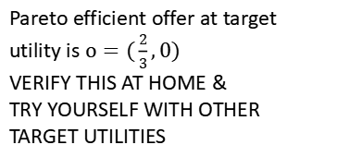


Offer-producing strategy
So far, the strategies discussed only provide a target utility. In a multi-issue negotiation, you need to generate a value for each issue.
It is a good idea to ensure that the offer is always Pareto efficient
if the utility functions are known, it is possible to calculate the Pareto-efficient offer at a certain target utility level
Suppose agent 2’s target utility is set to $U_{target}=8$
Agent 2's utility ($U_{2}$)
Pareto efficient offer at target utility is $o=(\frac{2}{3},0)$
VERIFY THIS AT HOME &
TRY YOURSELF WITH OTHER TARGET UTILITIES
Agent 1's utility ($U_{1}$)

Slide 56
Unknown Opponent Utility
Typically the opponent utility is not known, i.e. this is so-called private information
Possible to guess the opponent utility function based on the offers received so far and the concessions observed
E.g. the opponent is likely to concede on their least preferred issues first (in case of additive utility functions), and so you can use this to guess the weight of that issue
Many approaches in the literature and this will be discussed in more detail in the coursework labs

Slide 57
Preference Uncertainty and Elicitation
In many cases even “own” utility function is not (fully) known by the agent (who is negotiating on behalf of a human)
Utility function obtained through a process called preference elicitation
Has associated “cognitive costs”
Trade-off between minimizing cognitive cost and maximising utility
Some recent work has looked at negotiation with preference uncertainty: incomplete information about own utility
Preference uncertainty and elicitation will be explored as part of the coursework and more details will be discussed in a future lecture and the labs.

Slide 58
Conclusions
Agent-based negotiation is an extensive field of research
Focus on bilateral bargaining (between two agents) and multi-issue negotiation (allowing for mutually beneficial outcomes).
An important aspect of the agent is the negotiation strategy, which is challenging to design because of uncertainty about the opponent
Recent approaches consider incomplete information about own utility function, and the cost to elicit these preferences

